Slide 1
MINOR PROJECT JUIT MMS
Team Members:
Abhishek Thakur(191335)
Shivam Gour (191340)
Supervisor:
Dr. Pankaj Dhiman

Slide 2

Medical Management System

Slide 3
INTRODUCTION
1

Slide 4

This project aims towards developing a centralized mechanism for Medical Centre, JUIT .
Efficient storage of Medical logs containing information of Students and Doctors along with the appointments.
This product is a User Friendly Web Application of Database Management System to improve the existing system and make it paperless.

Slide 5
PROBLEM STATEMENT
2

Slide 6
Problem Statement
Current system uses Bookkeeping methods to store the medical logs.
Develop an application for efficient access of medical logs by the medical faculties.

Slide 7
Designing an web application for Database management of Medical unit and try to make it fast in terms of storing and retrieving the information.

Slide 8
DESIGN FLOW
3

Slide 9
Flow Chart
Formulation of Problem Statement
Features
Technical Stack
Conclusion +
Demo

Slide 10
TECHNICAL STACKS
4

Slide 11


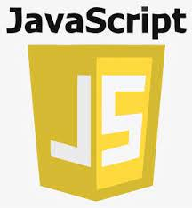



Technical Stack
Flask
JavaScript
VS Code
Bootstrap
AJAX
SQLite

Slide 12
VIEWS
5

Slide 13
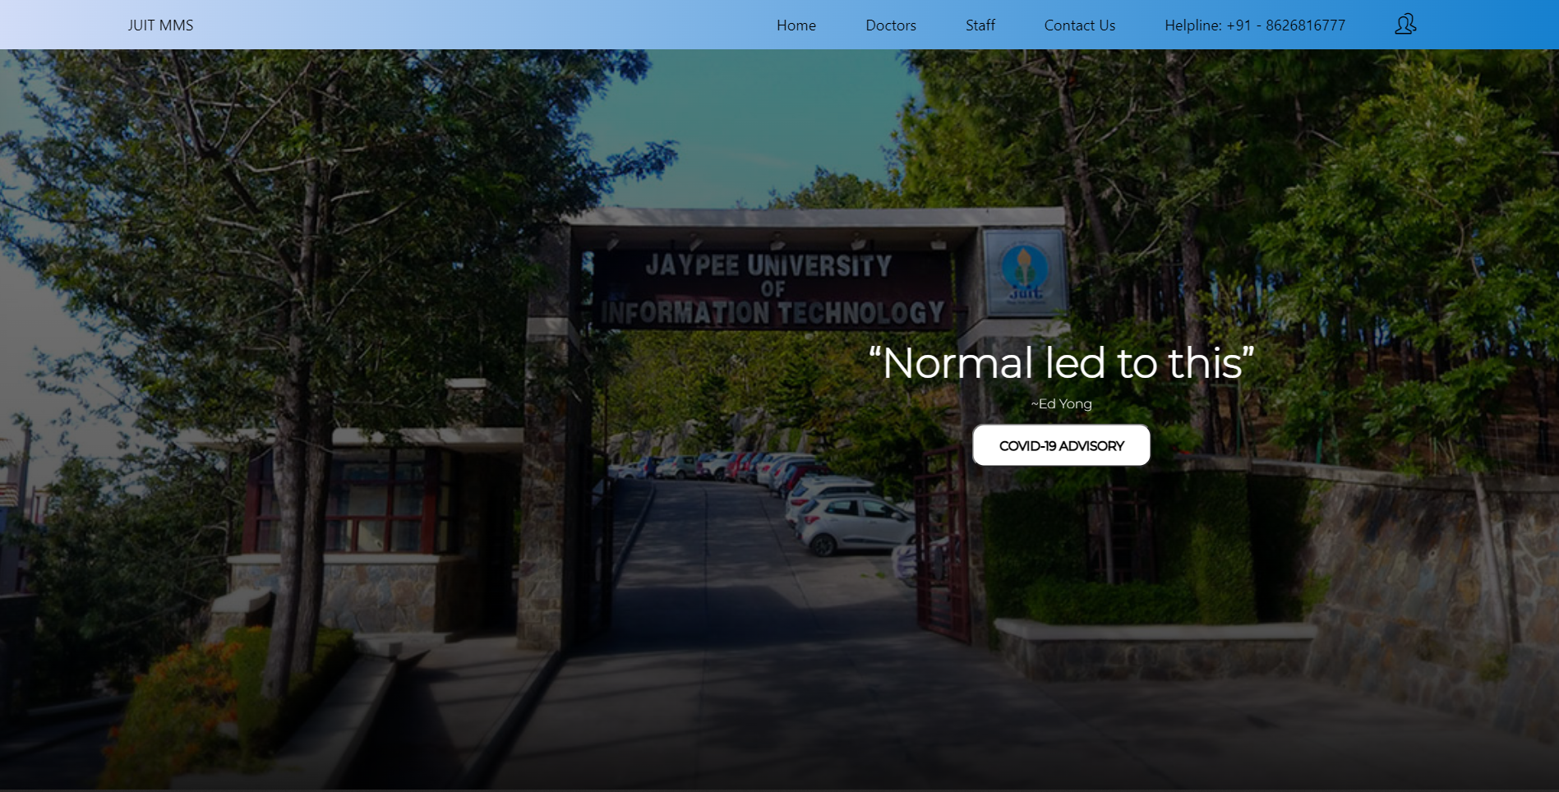
Home Page

Slide 14
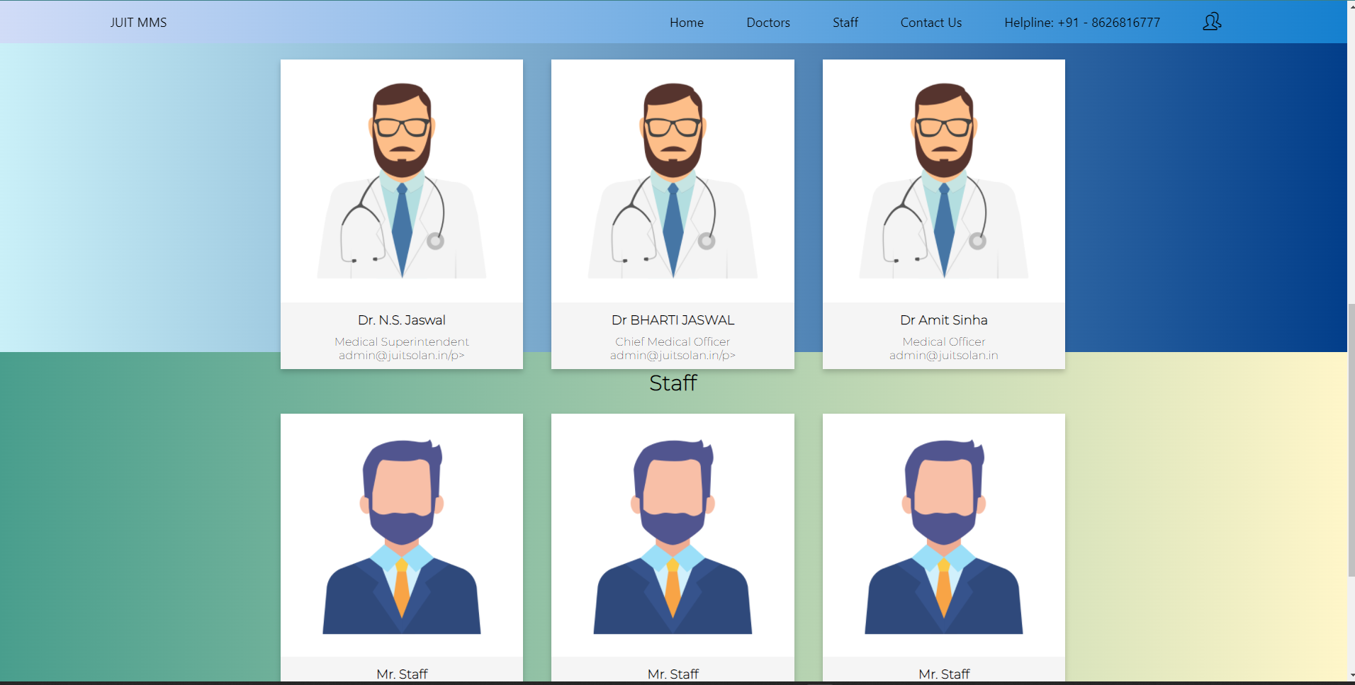
Home Page

Slide 15
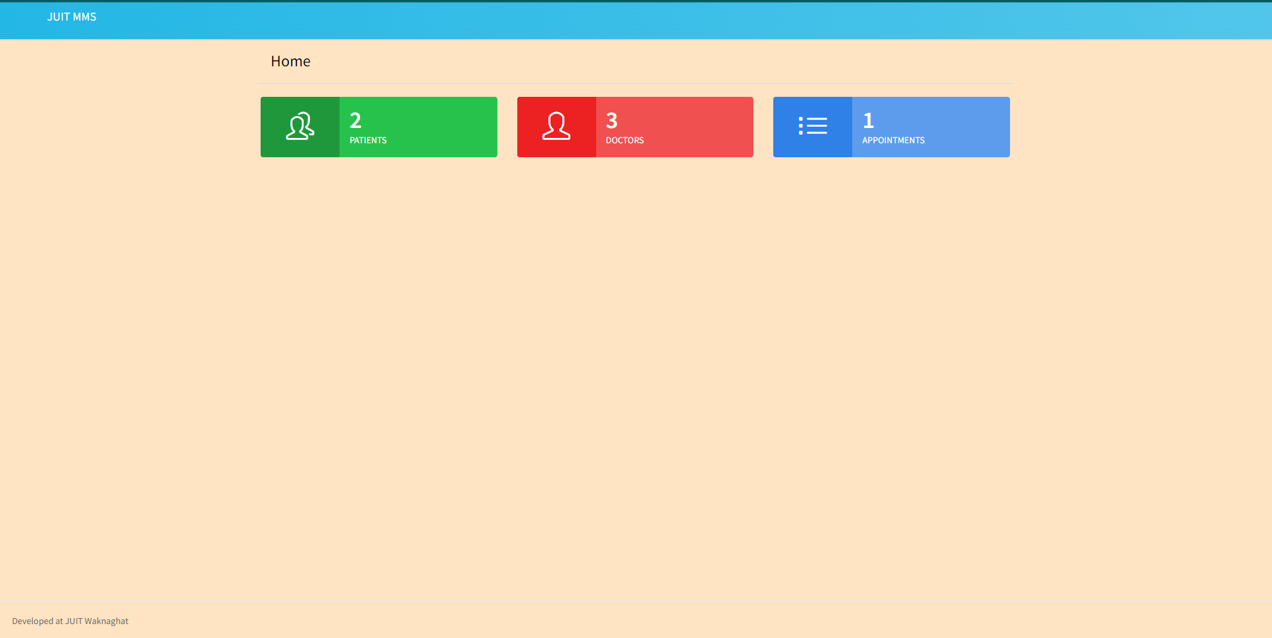
Admin View

Slide 16
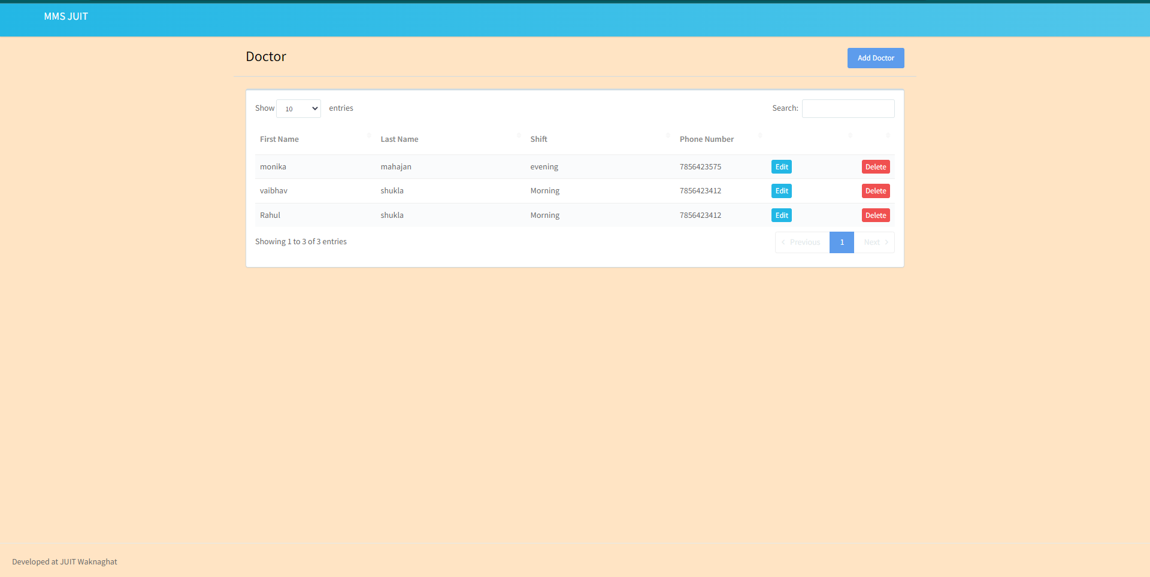
Doctor View

Slide 17
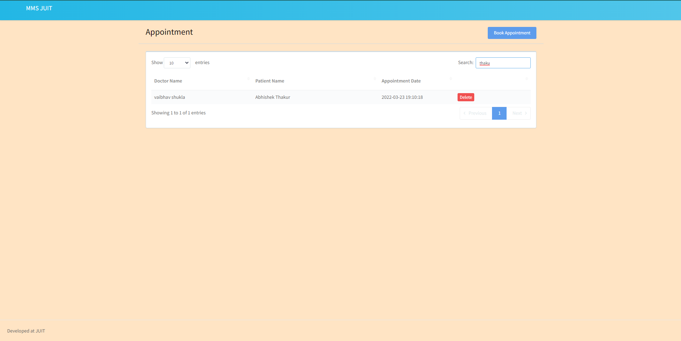
Appointment View

Slide 18

Features
6

Slide 19
Features
Multiple Types of User Entries
Improved Process
Increase In Productivity Of The End User
Appointment Scheduling
Digital Medical Records
Helpdesk And Support

Slide 20
DEMO
7

Slide 21
Future Scope
8

Slide 22
Future Scope
Authentication system
For different users viz Students, Employees, Doctors, Staff and Pharmacists.
Appointment management system
Automate this process to avoid such clashes by prior notifying the operator
Notification System
Notifying user for the scheduled appointments and availability of services.
Notes:
https://www.ringlead.com/blog/the-benefits-of-using-database-management-systems/

Slide 23
THANKS!

